Slide 1
IMPORT PROCESS VIA VLOOKUP

Slide 2
1) GO TO YOUR EXCEL SPREADSHEET – COPY A5-D5

Slide 3
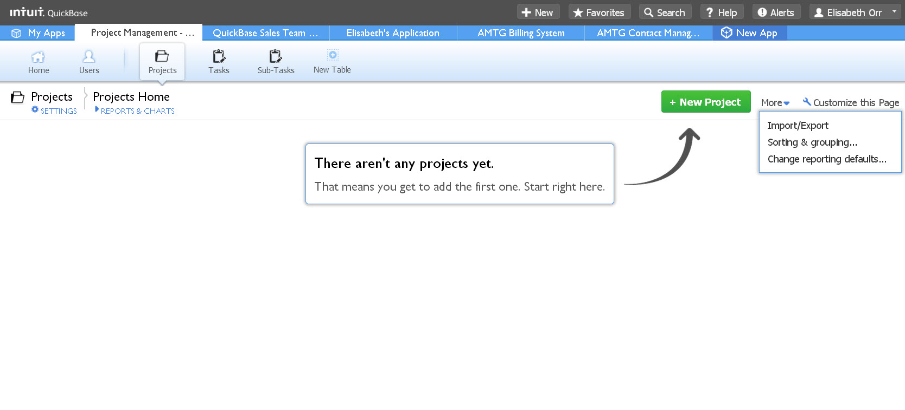
2) CLICK PROJECTS TABLE
3) CLICK IMPORT/EXPORT

Slide 4
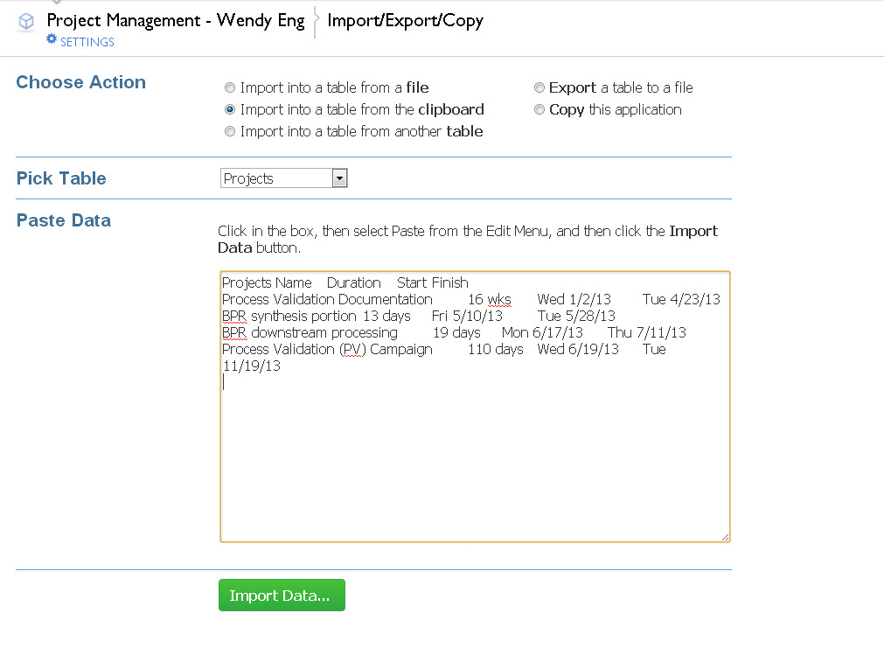
4) Import into a table from a clipboard
5) Pick a table – In this case Projects
6) Paste the copies cells from excel in the empty box. No need to format.
7) Click Import Data

Slide 5
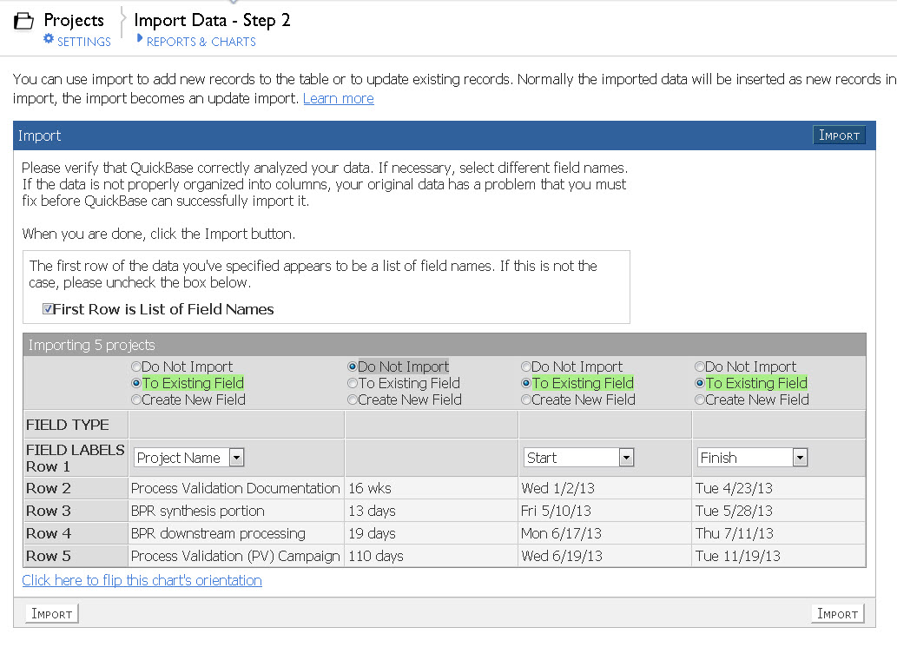
8) Do not import duration. The formula that you entered will do the calculation for you. Verify the fields match, for example: Project Name is going to be imported to an existing field “Project Name”.
9) Click Import

Slide 6
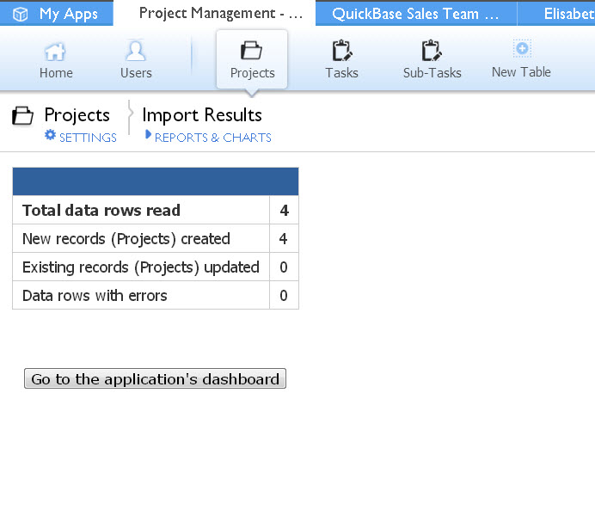
You will be directed to this page.
10) Click Go to the Application’s Dashboard

Slide 7
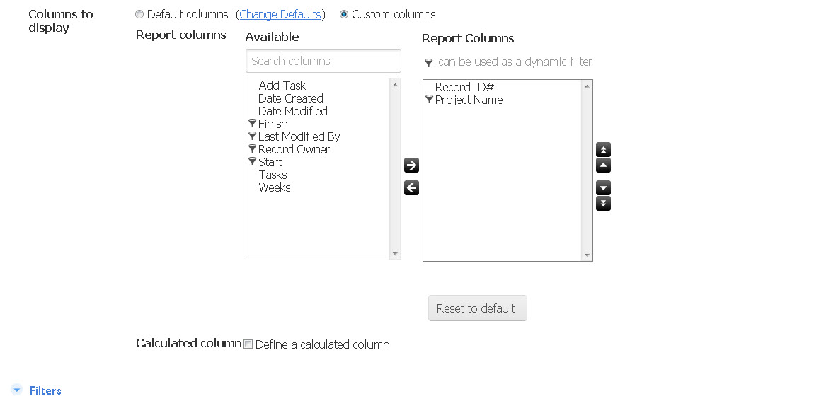
11) Create a Table Report that includes the Record ID# and the Project Name, Customer Name, etc

Slide 8
12) The report will look like this

Slide 9
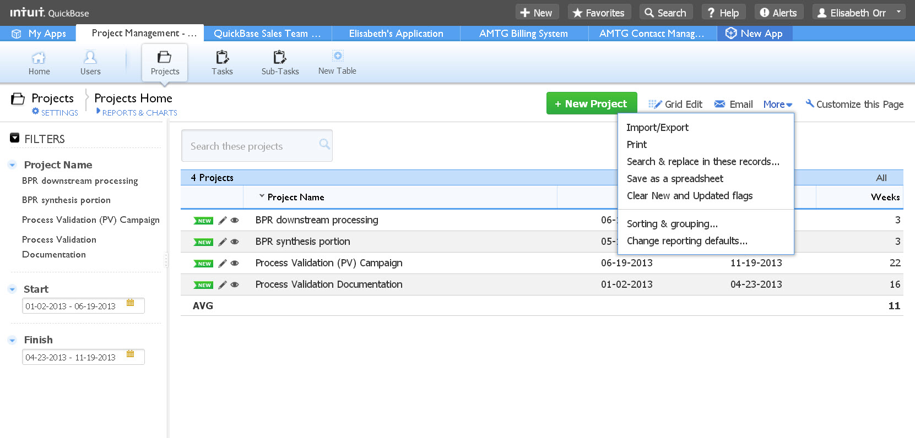
13) Go to Projects Table
14) Click More
15) Click Import/Export

Slide 10
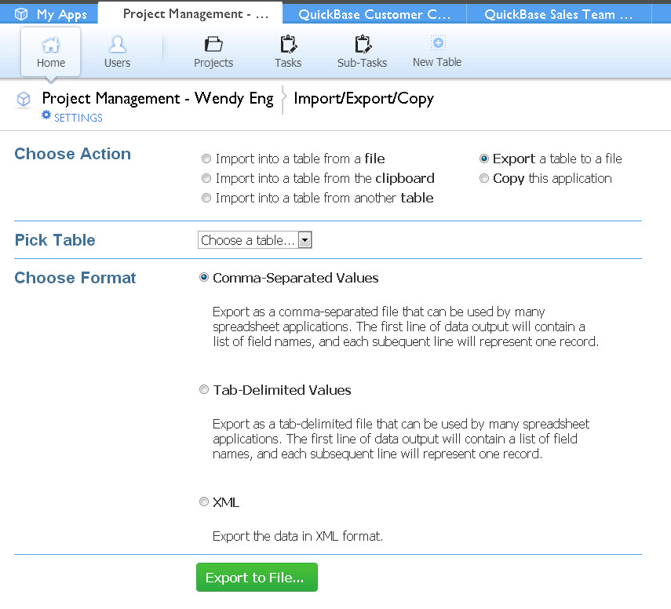
16) Export a Table to a file
17) Select a Table - Projects
Click Export to File

Slide 11
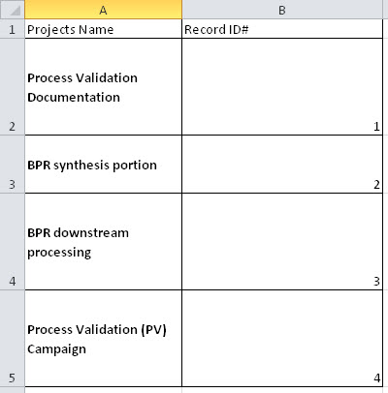
18) Open exported file
19) Create a second sheet in the original import excel spreadsheet – add the following columns from the above export file

Slide 12
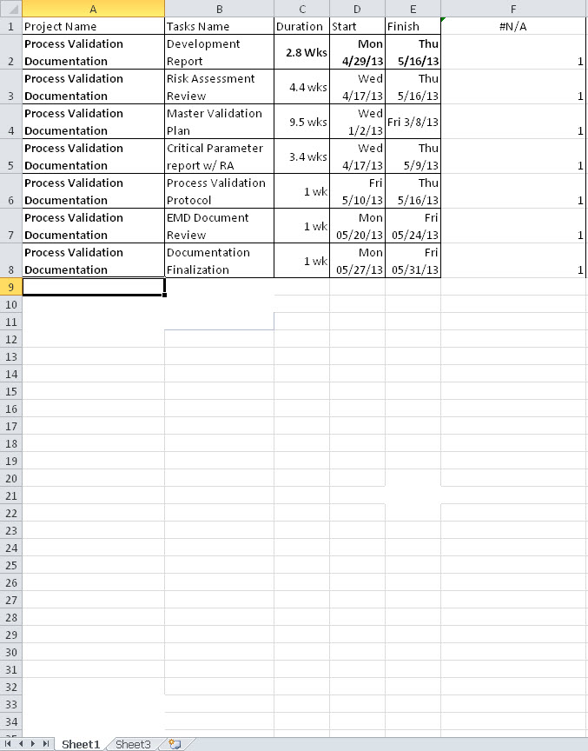
=VLOOKUP(A:A,Sheet3!A:B,2,FALSE)
20) On Sheet 1 of your original
import file, in Column F
(or the next blank column)
Perform the following steps:
In F1 Type =VLOOKUP
Enter an open Parenthesis
Select Column A
Enter a Comma
Click Sheet 3 on the Bottom of the page
Highlight Columns A & B
Press F4
Enter a Comma
Enter the column you want to “reference” which is B, the 2nd column – so 2
Enter a Comma
Then double click on FALSE
Enter a close Parenthesis
SHEET 3

Slide 13
21) Copy A1-F8

Slide 14
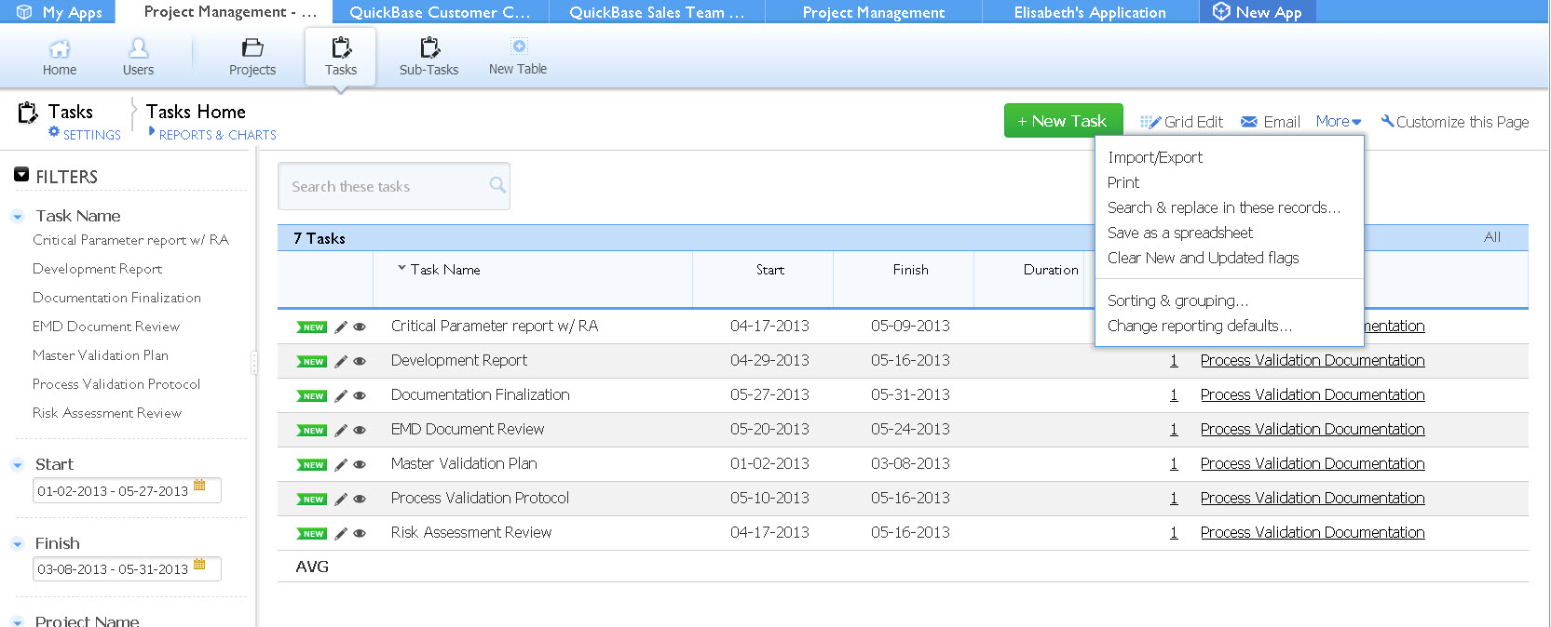
22) Go to your Tasks Table
23) Click more
24) Click Import/Export

Slide 15
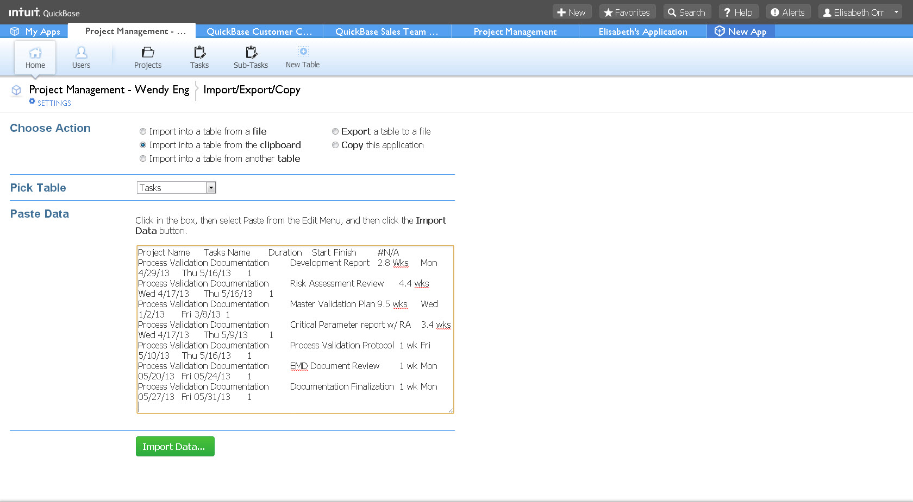
25) Paste your data from cells A1-F8
27) Click Import Data

Slide 16
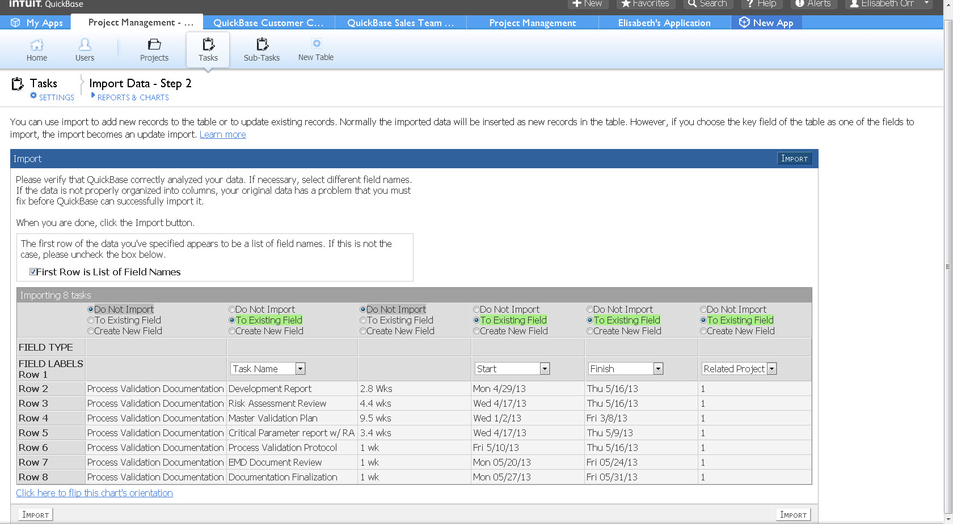
The last field should say Related Project. Verify the fields match, for example: Task Name is going to be imported to an existing field “Task Name”. Do not import duration or Project Name
26) Click Import

Slide 17
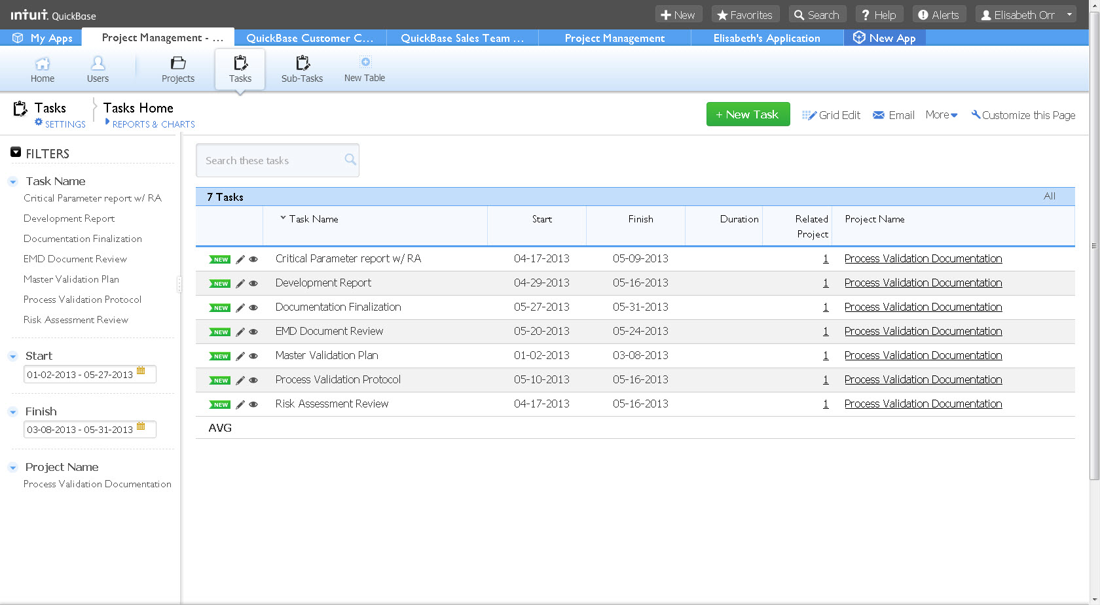
Now your tasks will relate to the correct Project. If you look back over the spreadsheet remember that the project that these tasks are related to are part of record id # 1. If you have sub-tasks, or additional projects you would simply add on to your spreadsheet or repeat the process.

Slide 18
Any Questions?
Contact: Elisabeth Orr
Elisabeth_Orr@intuit.com

